Slide 1
Department Head Expectations
Steve Abel
Associate Vice Provost for Faculty Affairs

Slide 2
Essentials
Distribution of effort
  Know your distribution of effort
  Learning/teaching
  Discovery/scholarship
  Engagement/service
  Identify metrics that relate to you and your goals
  Align your activities accordingly
Strategic plan
  Know the strategic plan from the University, College/School, Department
  Identify metrics that relate to you and your goals
  Align your activities accordingly

Slide 3
Essentials
Guidelines for annual performance review
  Secure a copy of the guidelines for annual performance review
  Example:
  Teaching
  Undergraduate/professional
  Graduate
  Evidence of teaching/learning effectiveness
  Grantsmanship
  Presentations
  Scholarly publications
  Engagement
  Citizenship
  Awards
  Teamwork
  Goals
  Process for the provision of written feedback

Slide 4
Essentials
Faculty orientation
Orientation checklist and plan
  Annual faculty expectations
  Guidelines for promotion and/or tenure
  Journal listing (required for promotion process)
  Format for promotion and/or tenure document
  Guidelines for evaluation of teaching
  Development plan moving toward promotion and/or tenure
  Mentoring plan (individual mentors for teaching, research)
Criteria and format for promotion document
What are the criteria?
How are you evaluated relative to promotion and how is this different from the annual merit salary review?
Frequency of evaluation
Evaluators
Is there a formal third year evaluation?
Is there external input into the review(s)?

Slide 5
Essentials
University resources
Center for Instructional Excellence (CIE)
Research Orientation – Office of the Vice President for Research
Faculty Fellowship for Study in a Second Discipline
Butler Center for Leadership Excellence
Conference for Pretenure Women
Own the process!!

Slide 6
Written Feedback
TO:
DATE:
RE: Performance Assessment
This memorandum will serve as a written summary of your performance as reflected in the report submitted to me as well as our discussion.
Category | Assessment | Comments
Discovery/Scholarship
Learning
Engagement
Citizenship
Administration
Awards/Recognition
Teamwork
E = Exceeds Expectations
O = Meets Objectives
N = Needs Improvement
N/A = Not Applicable

Slide 7
Weighted Evaluation - Research
Discovery/Scholarship – Percent Effort _____%
Grants (per grant) | Points
Extramural Grants
Principal investigator with salary coverage | 3
Principal investigator without salary coverage | 2
Co-Investigator (or PI of subcontract) with salary coverage | 2
Co-Investigator (or PI of subcontract) without salary coverage | 1
Intramural Grants
Principal investigator with salary coverage | 2
Principal investigator without salary coverage | 1
Co-Investigator (or PI of subcontract) with salary coverage | 1
Points (max 15)
Publications (per publication)
Tier 1 publication authorship or book author or editor of a book | 3
Tier 2 publication authorship or book chapter author | 2
Tier 3 publication authorship | 1
First or corresponding author on a Tier 1 or 2 publication (additional points per publication) | 1
Points (max 15)
Presentations (per presentation)
Primary presenter, research/scholarship presentation (platform/poster) – International/national meeting | 5
Non-primary presenter, research/scholarship presentation (platform/poster) – International/national meeting | 4
Primary presenter, research/scholarship presentation (platform/poster) – State/local meeting | 3
Points (max 10)
Research Subtotal (max 40) _____ x _____ % =

Slide 8
Weighted Evaluation – Learning
Learning – Percent Effort _____%
Teaching
Lecture contact hours (per 5 hours actually presented, round appropriately) (0 for guest lecturers) | 1
Laboratory sessions
Laboratory session coordinator (per semester) | 3
Laboratory session instructor (per semester) | 2
Laboratory session co-instructor (per semester) | 1
Laboratory sessions developed (per unique session) | 3
Core courses coordinated (per course) | 9
Elective courses coordinated (per course) | 6
Points (max 25)
Students
PharmD students precepted (per year)
1-6 students | 1
7-12 students | 2
>12 students | 3
PharmD projects coordinated (per project) | 1
Graduate student committee chair (per committee) | 3
Graduate student committee member (per committee) | 2
Fellowship program director (per program) | 3
Fellowship program committee member (per program) | 2
Residency program director (per program) | 3
Residency/fellow rotations precepted (per year)
1-6 rotations | 1
7-12 rotations | 2
>12 rotations | 3
Points (max 15)
Learning Subtotal (max 40) _____ x _____ % =

Slide 9
Case: P&T
Third year review
Effort: 35% teaching; 35% engagement (patient care); 30% research/scholarship
Teaching evaluations
  3.8-4.3 on 5 point scale
  Peer comparison range 3.5 – 4.8
Extramural contract funds 40% salary for patient care activities; no funded grants
Scholarship
  Completely revamped core course syllabus
  No evidence of peer reviewed publications
P&T Feedback
  Deficit in scholarly activity raises concerns regarding ability to succeed

Slide 10
Tools to Facilitate Success

Slide 11
Myers-Briggs Type Indicator (MBTI)

Slide 12
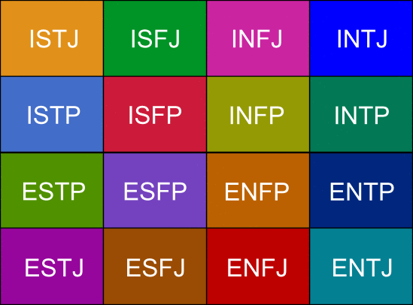
MBTI: Personality Type
Your Personality Type:
  When you decide on your preference in each category, you have your own personality type, which can be expressed as a code with four letters.
16 Available Personality Types

Slide 13
StrengthFinders

Slide 14
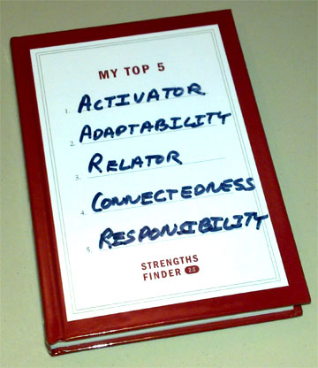
StrengthFinders: Themes
Achiever
Activator
Adaptability
Analytical
Arranger
Belief
Command
Communication
Competition
Connectedness
Consistency
Context
Deliberative
Developer
Discipline
Empathy
Focus
Futuristic
Harmony
Ideation
Includer
Individualization
Input
Intellection
Learner
Maximizer
Positivity
Relator
Responsibility
Restorative
Self-Assurance
Significance
Strategic
Woo

Slide 15
DiSC Model of Human Behavior

Slide 16

DiSC Classic
Describes how respondents tend to behave when they
respond emotionally to their environment, especially when the emotions have to do with how they see themselves in relation to the environment.
The level of scores indicates how intensely they react to the perceived relationship.

Slide 17
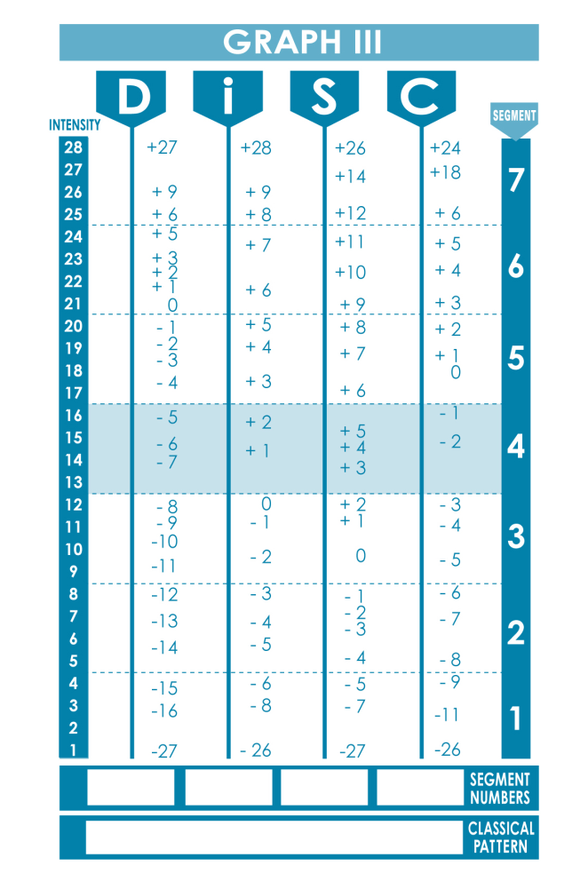

Slide 18




Introduction to the Styles
Priorities
D is for Dominance
Emphasis on shaping the environment by overcoming opposition to accomplish results.
Getting immediate results
Taking action
Challenging self and others
i is for Influence
Emphasis on shaping the environment by influencing or persuading others.
Taking action
Collaboration
Expressing enthusiasm
S is for Steadiness
Emphasis on cooperating with others within existing circumstances to carry out the task.
Giving support
Collaboration
Maintaining stability
C is for Conscientiousness
Emphasis on working conscientiously within existing circumstances to ensure quality and accuracy.
Ensuring accuracy
Maintaining stability
Challenging assumptions

Slide 19
Final Thoughts and Questions

